Slide 1
Model Selection and Comparison
Christian Ranaivoson
E2M2 2025 Andasibe, Madagascar
University of Chicago, USA ; Association Ekipa Fanihy; University of Antananarivo, Madagascar
Adapted from Cara Brook, Jessica Metcalf, Christian Ranaivoson E2M2 2022-2024.

Slide 2
Goals of the lecture
Introduction to model selection
Be familiar with common measures of model fit
Tutorial on how to do it in practice (Real example)

Slide 3
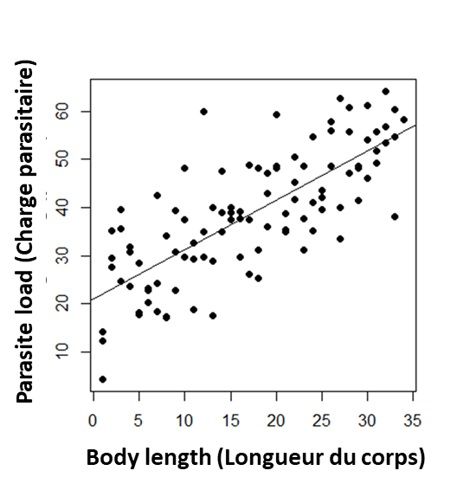
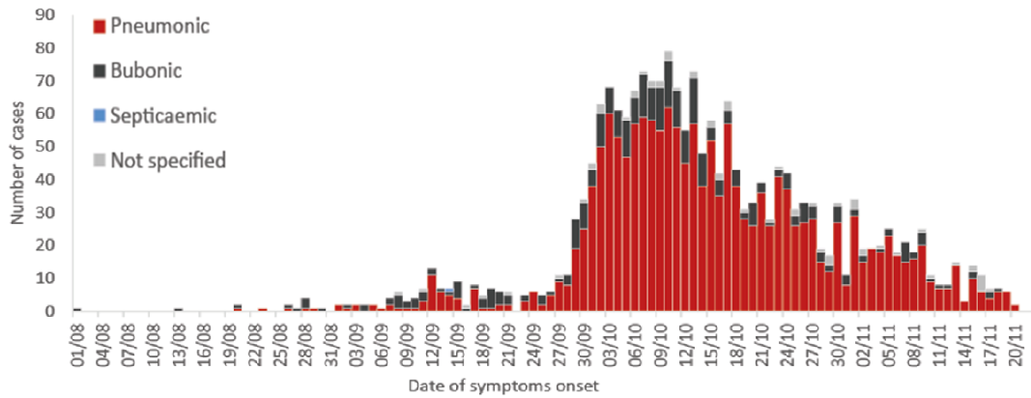
Which model is best?
Notes:
and the point will be it depends on the question.
https://www.ncbi.nlm.nih.gov/pmc/articles/PMC2566243/

Slide 4
There are many statistical methods used to ‘fit’ models to data and there are many possible scenarios from which mechanical model can be built.

Slide 5
There are many statistical methods used to ‘fit’ models to data and there are many possible scenarios from which mechanical model can be built.
The method best suited for your work will depend on your data and your question.

Slide 6
There are many statistical methods used to ‘fit’ models to data and there are many possible scenarios from which mechanical model can be built.
The method best suited for your work will depend on your data and your question.
What are some measures of model fit that you could use?

Slide 7
What are some measures of model fit that you could use?
Maximum likelihood
(Maximum de vraisemblance)
(izay manakaiky indrindra ny tena izy ry reto an)
R-squared
(R-carré)
Least squares
(Moindres carrés)
Hirotugu Akaike
AIC
(uses least squares or log-likelihood but penalizes by number of fitted parameters)

Slide 8
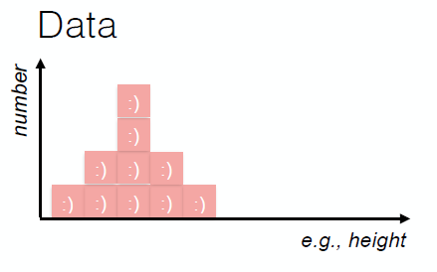
Maximum likelihood
f(x|μ, σ²)

Slide 9
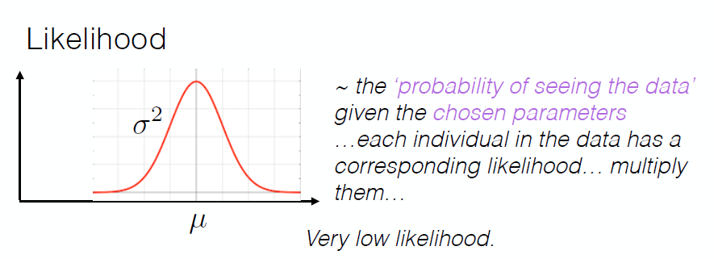
Maximum likelihood
f(x|μ, σ²)

Slide 10
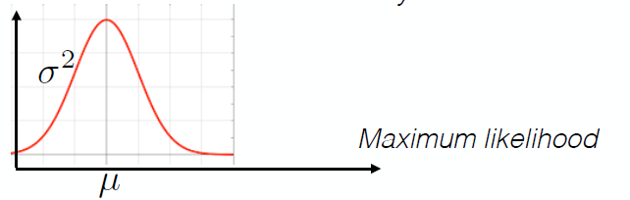
Maximum likelihood
f(x|μ, σ²)

Slide 11
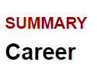
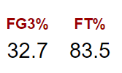

Likelihood
Vraisemblance
Examples:
R function : dbinom(x, size, prob, log=T)
R function : dbinom(8, 10, 0.835) = ?

Slide 12
Likelihood
Vraisemblance
Examples:
R function : dbinom(x, size, prob, log=T)
R function : dbinom(8, 10, 0.835) = 0.289

Slide 13
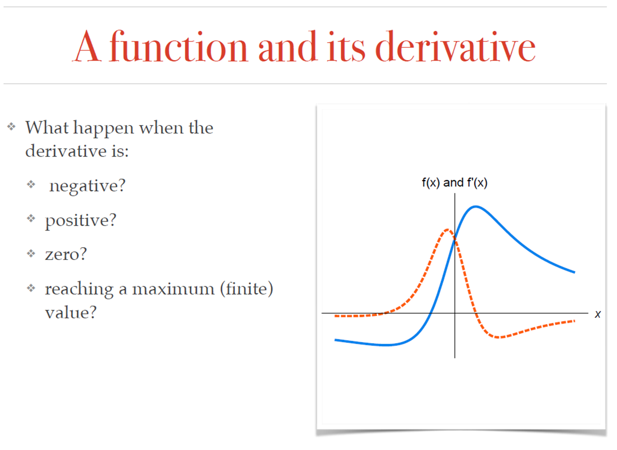
Optimization/maximization
From Tanjona Ramiadantsoa

Slide 14
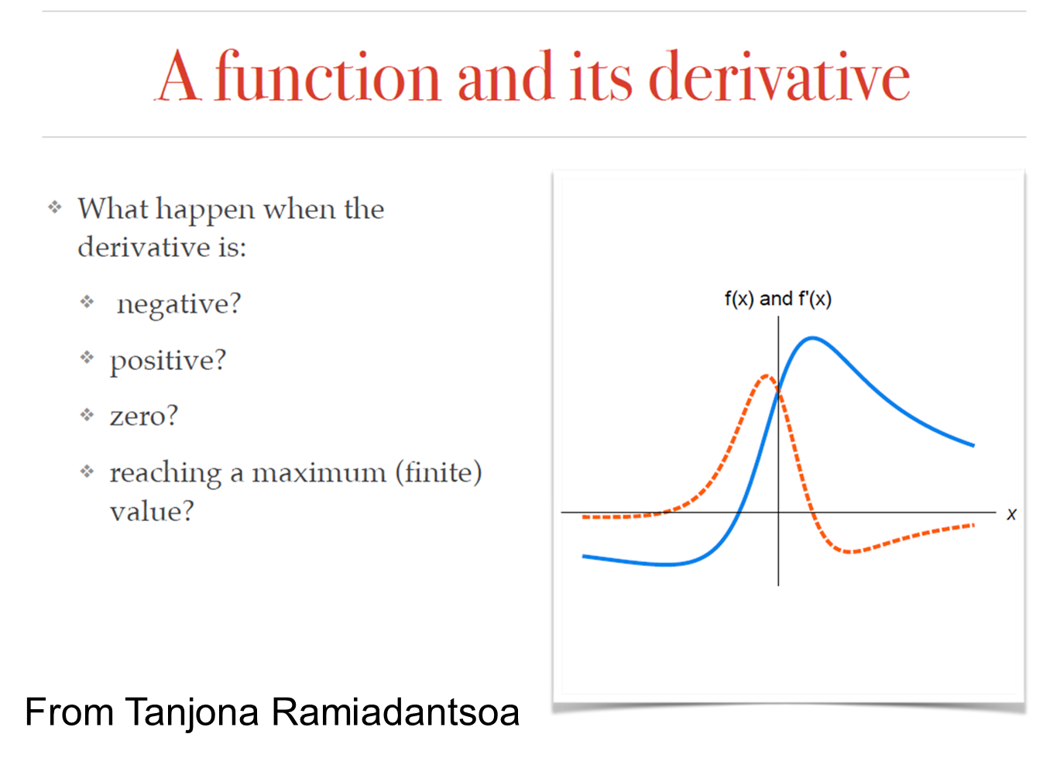
Optimization/maximization
The R function ‘optim’ can be used to find minimum/maximum.

Slide 15
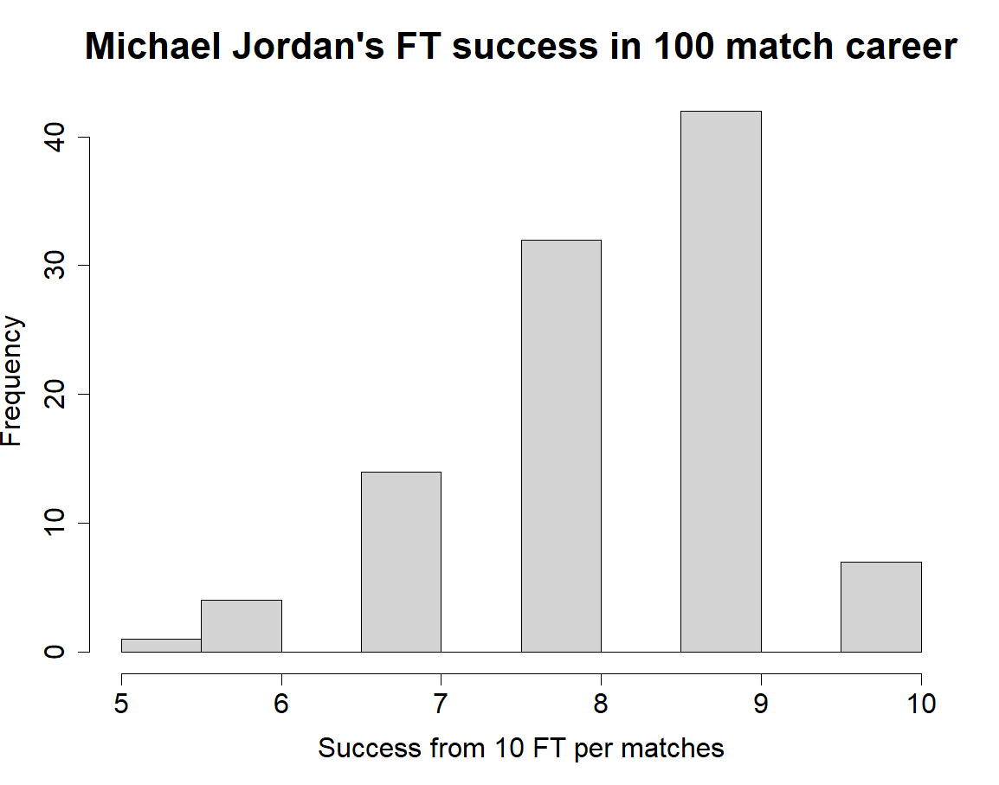
Number of match played

Slide 16
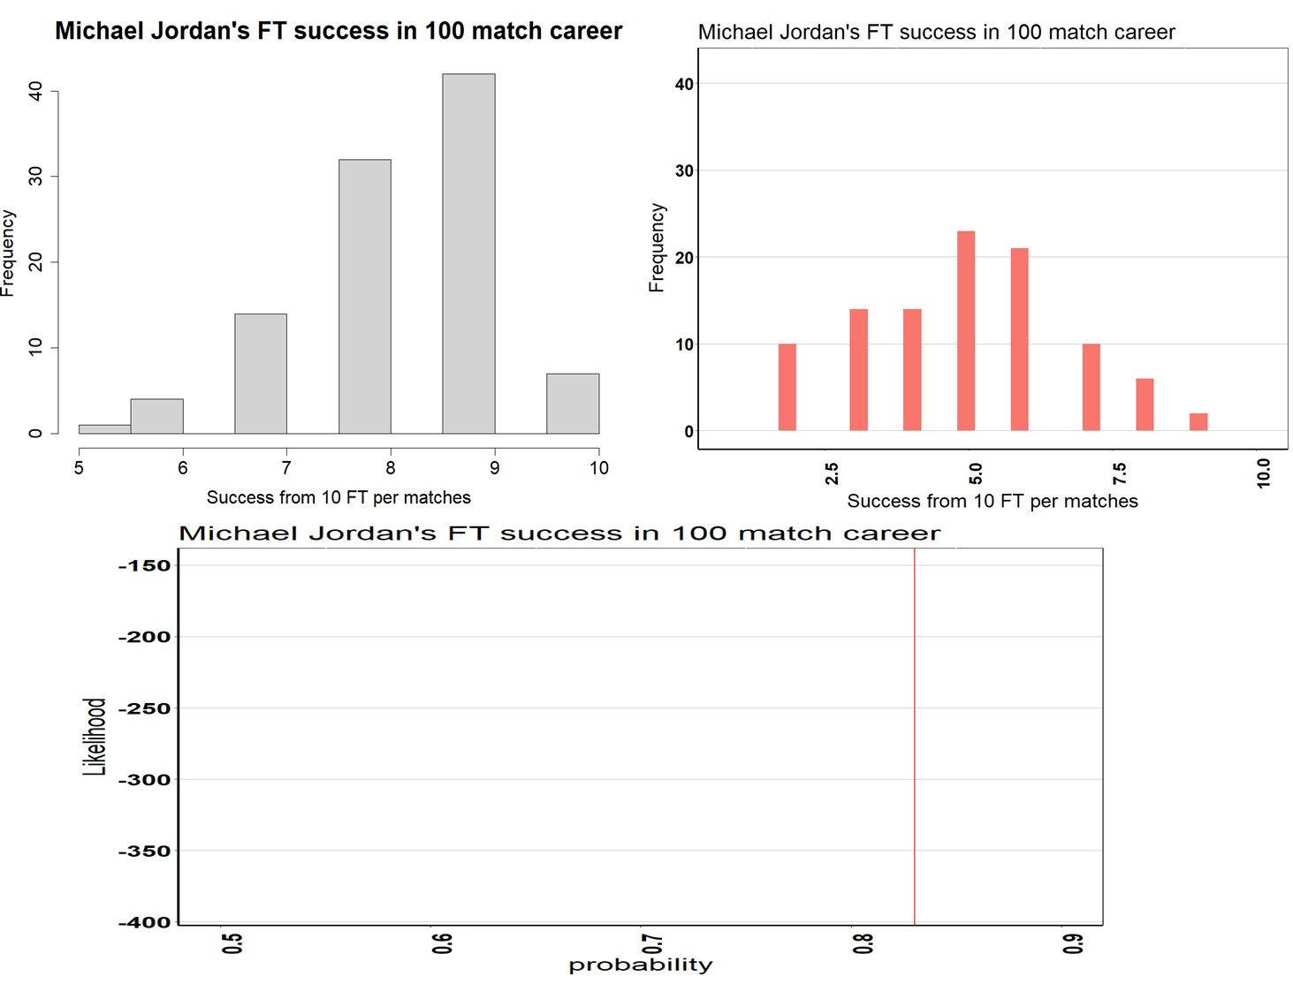

Slide 17
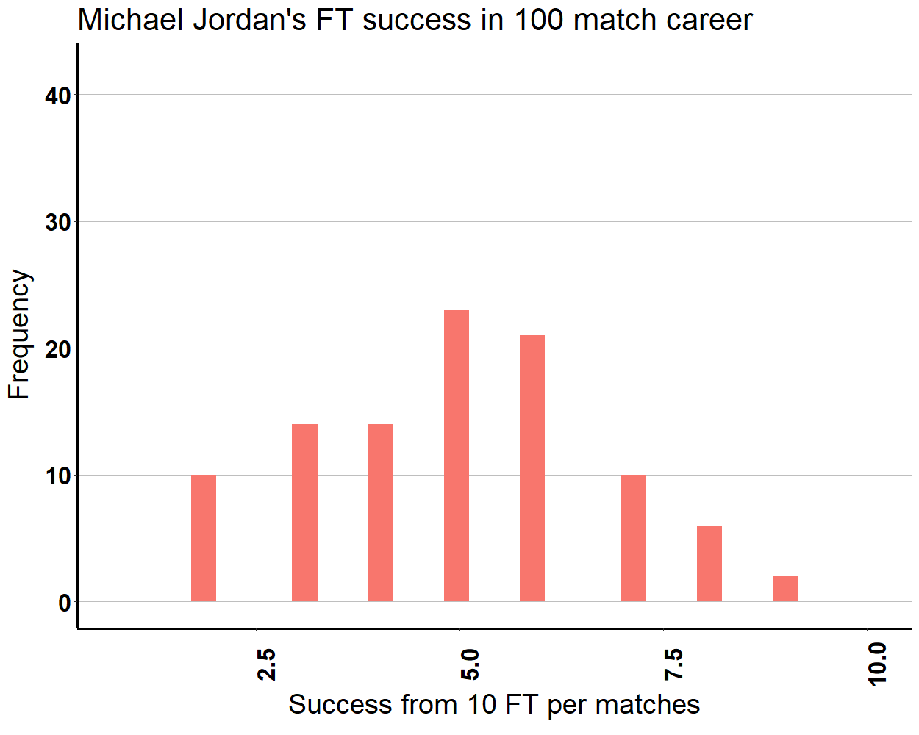
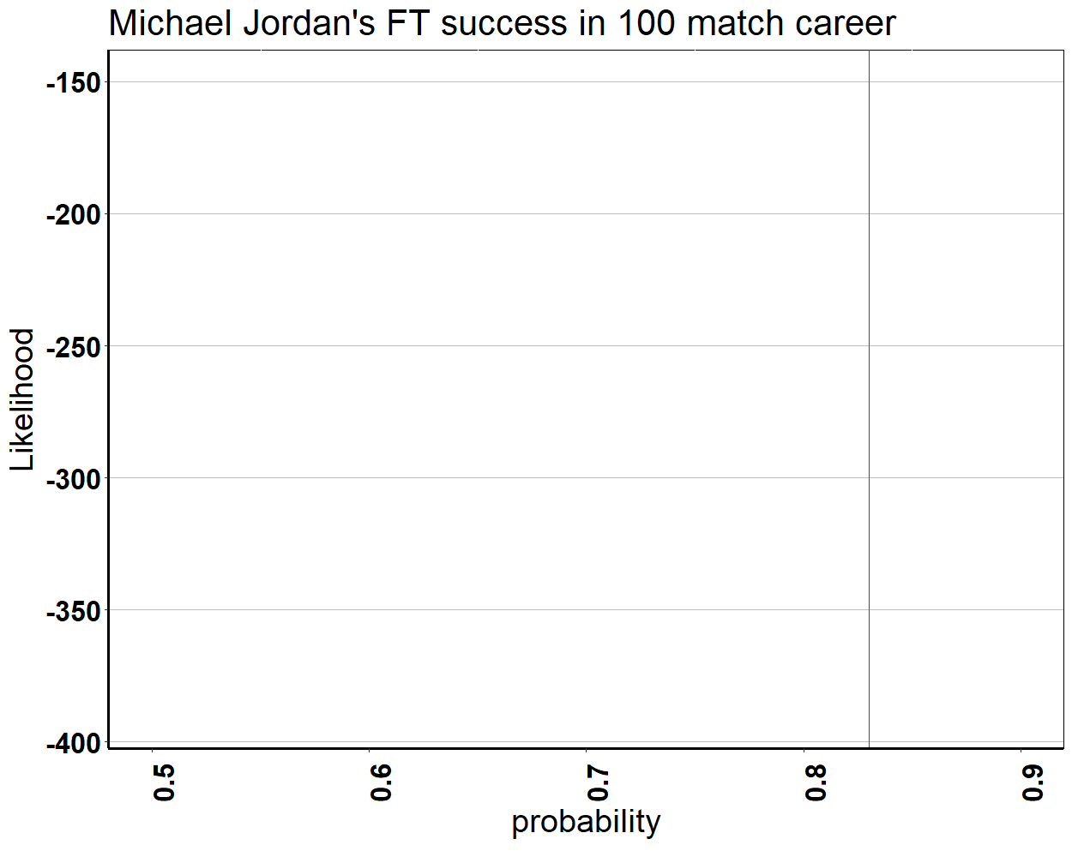
Number of match played
Number of match played

Slide 18
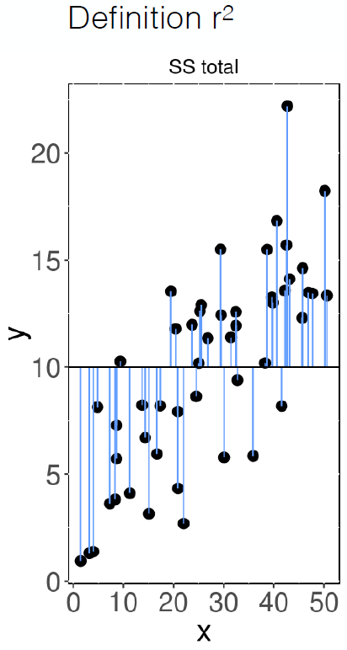
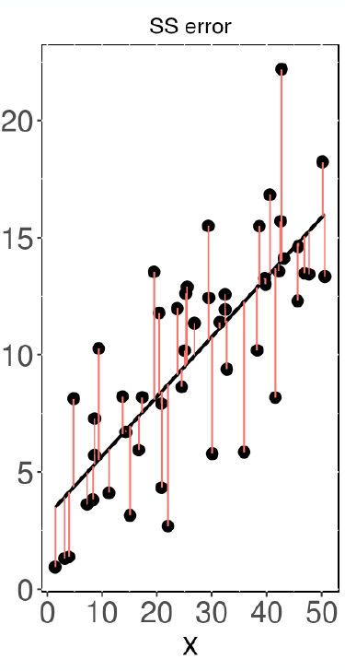
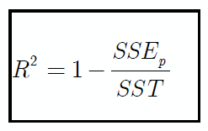

Slide 19
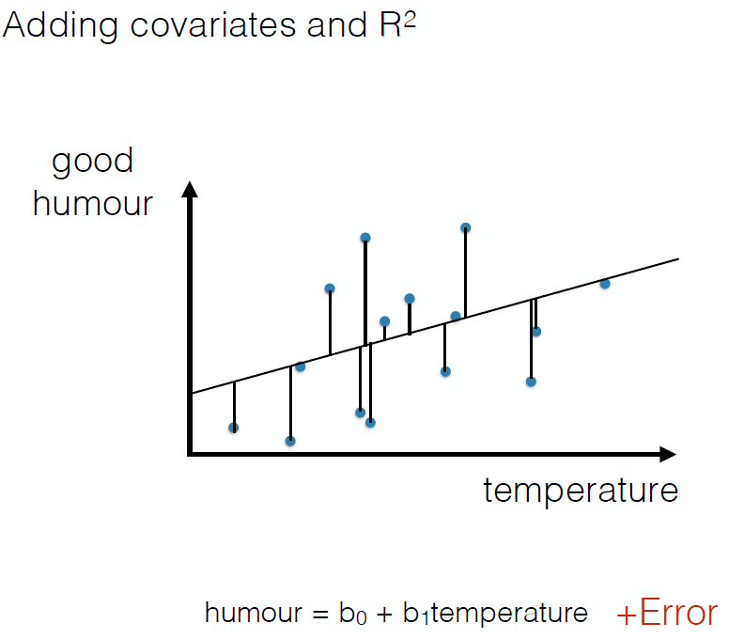
Least squares
2K

Slide 20
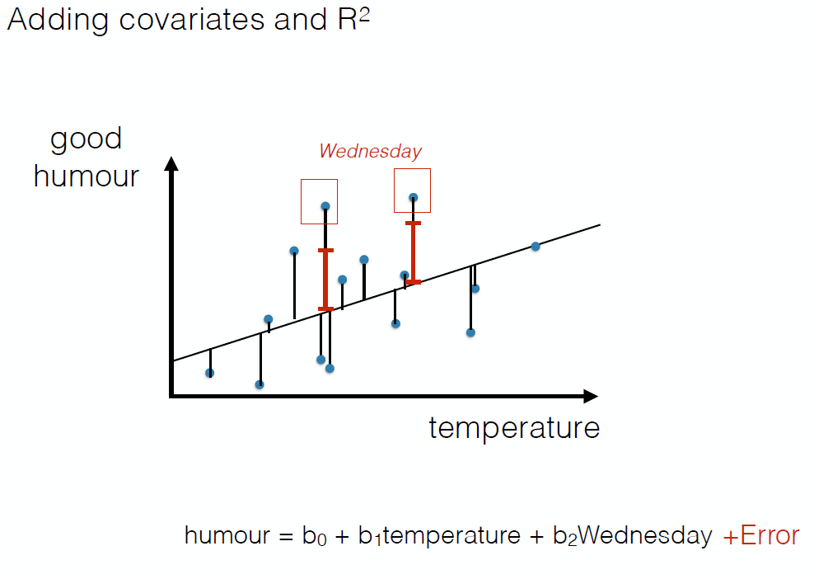
Least squares
3K

Slide 21
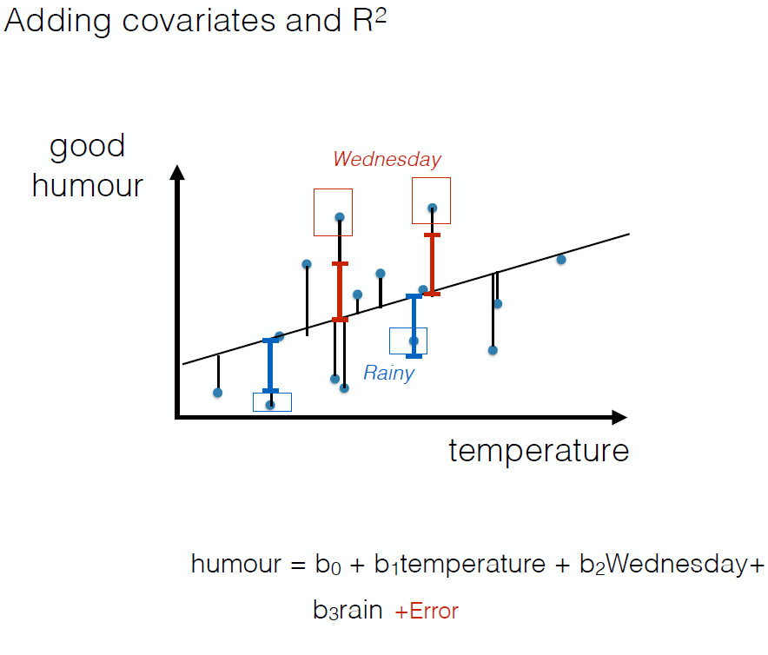
Least squares
4K

Slide 22
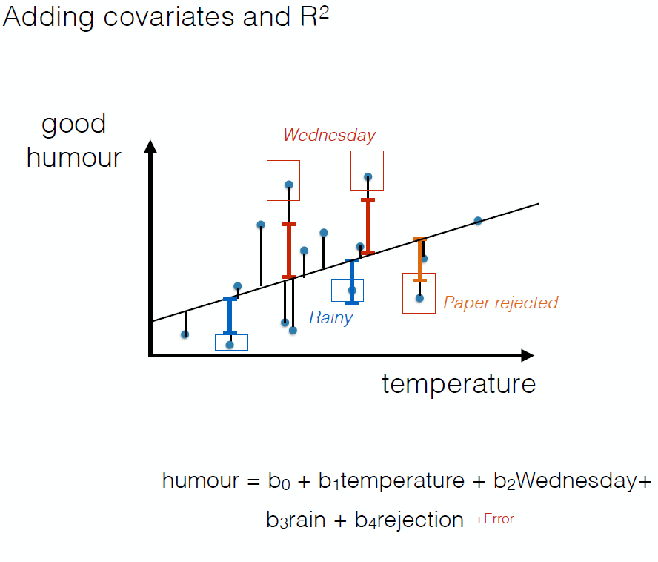
Least squares
5K

Slide 23
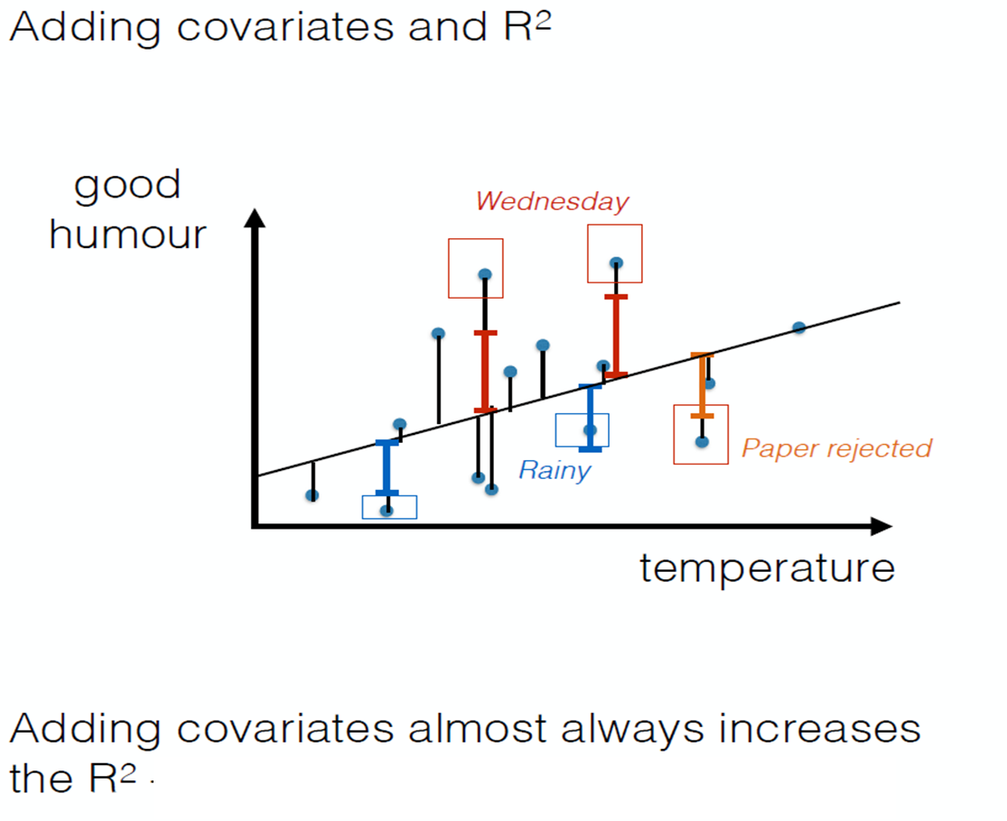
Least squares

Slide 24
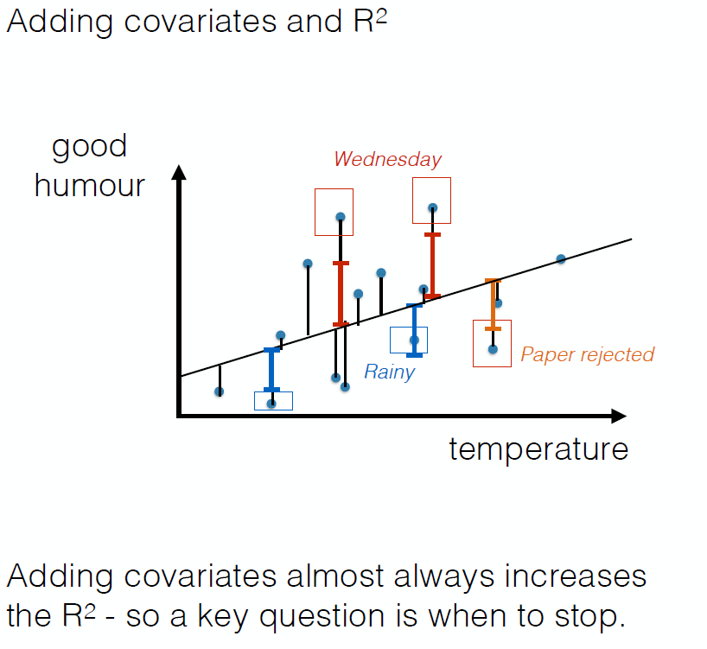
Least squares

Slide 25
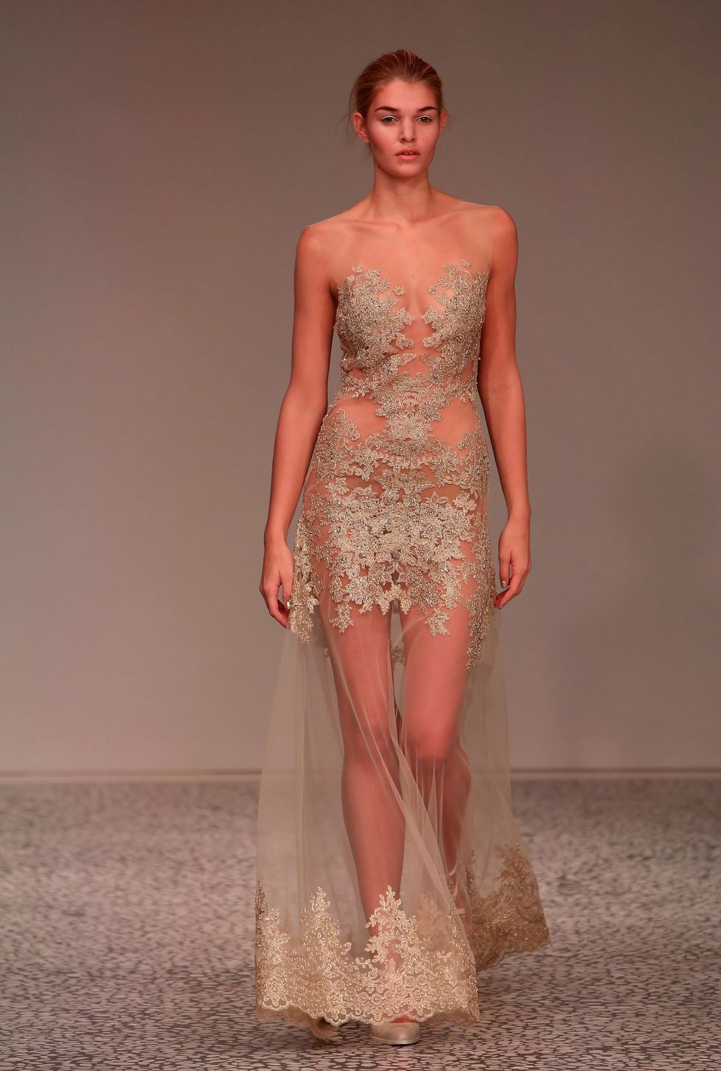
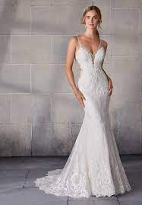

What to choose?

Slide 26
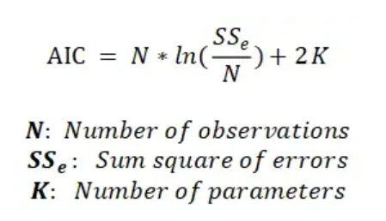
Least square AIC
The smaller the AIC the better

Slide 27
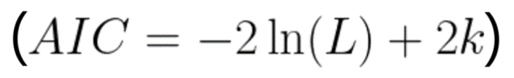
Least square AIC
More parameter is not always good
The smaller the AIC the better

Slide 28

An example of model selection: Bartonella spp. in Madagascar rats

Slide 29
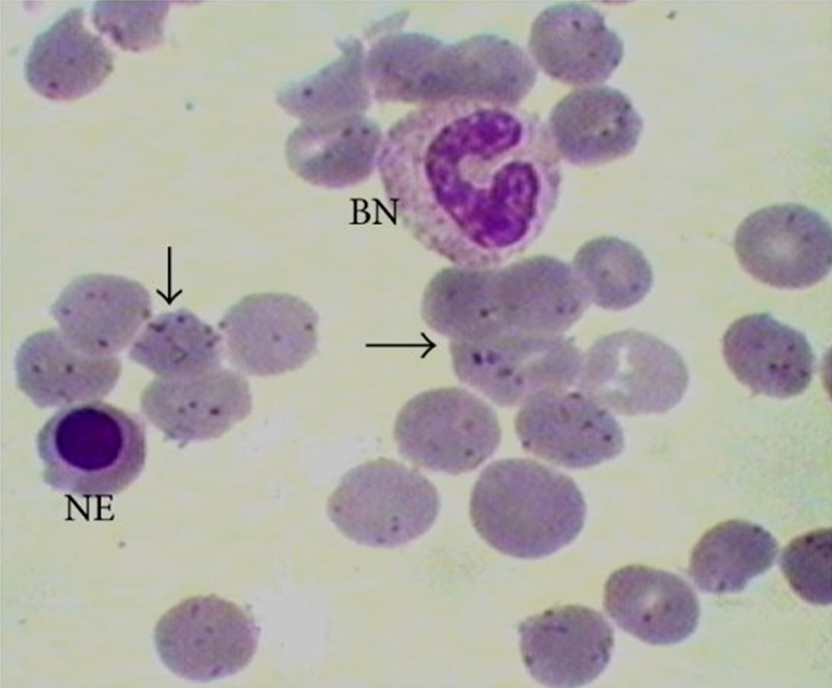
Bartonella spp.
Persistent erythrocytic bacteria that are sometimes zoonotic
Vectored by ticks, fleas, sand flies, mosquitoes
Some species infect humans
Bartonella bacilliformis = Carrion’s disease
Bartonella henselae = cat scratch fever
Bartonella quintana = trench fever

Slide 30
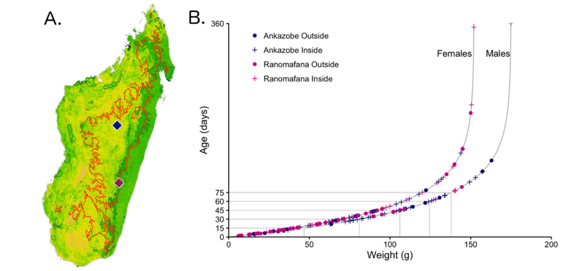
We first collected samples from rats from two sites in Madagascar.
(Ricker 1979)

Slide 31
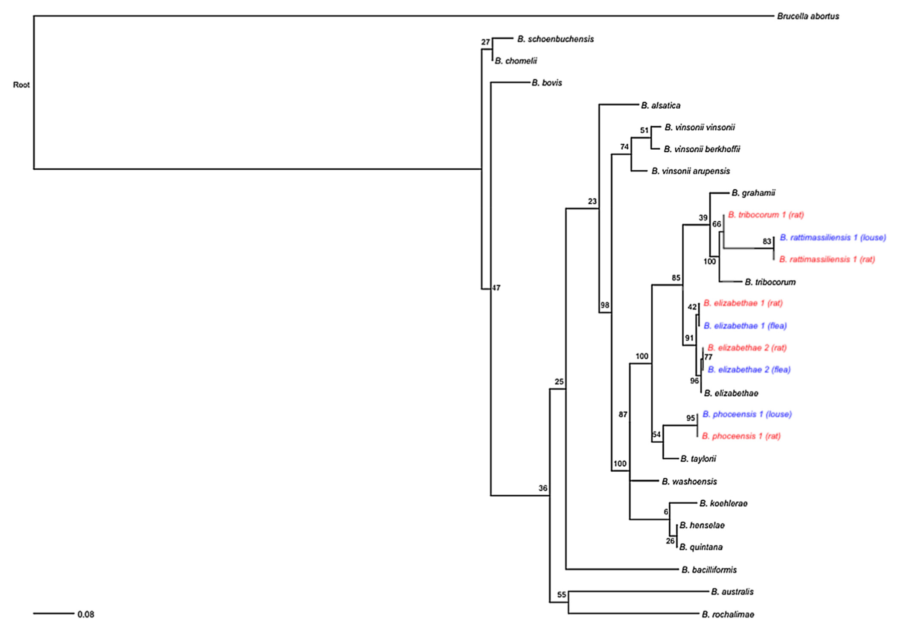
Statistically, we demonstrated an association between genotypes of Bartonella spp. found in rats and their ectoparasites.

Slide 32
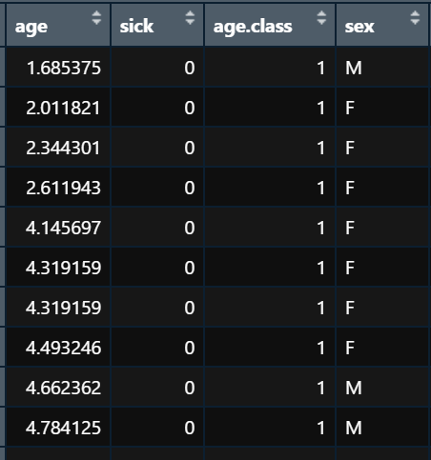
Then, we asked: How does the rate of becoming infected vary with age?

Slide 33
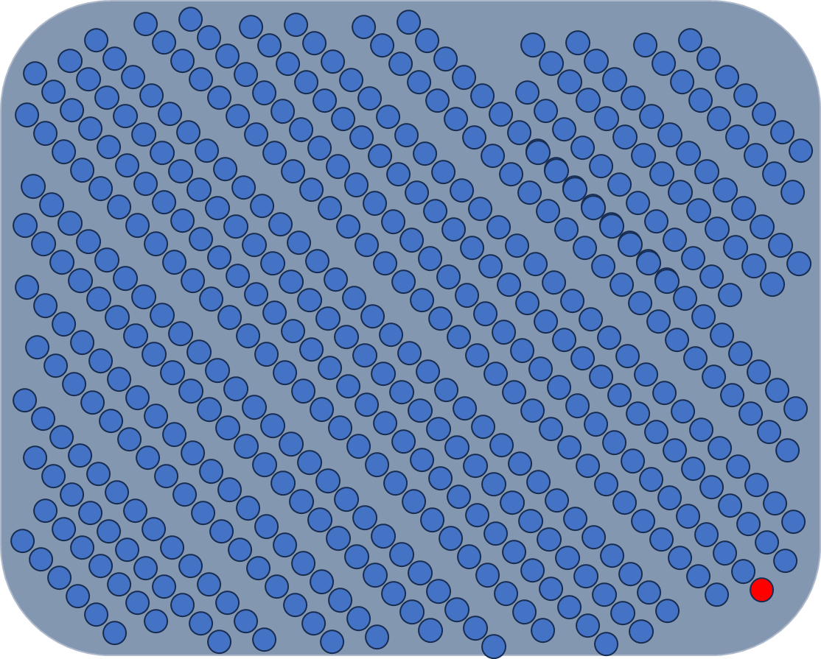

Slide 34
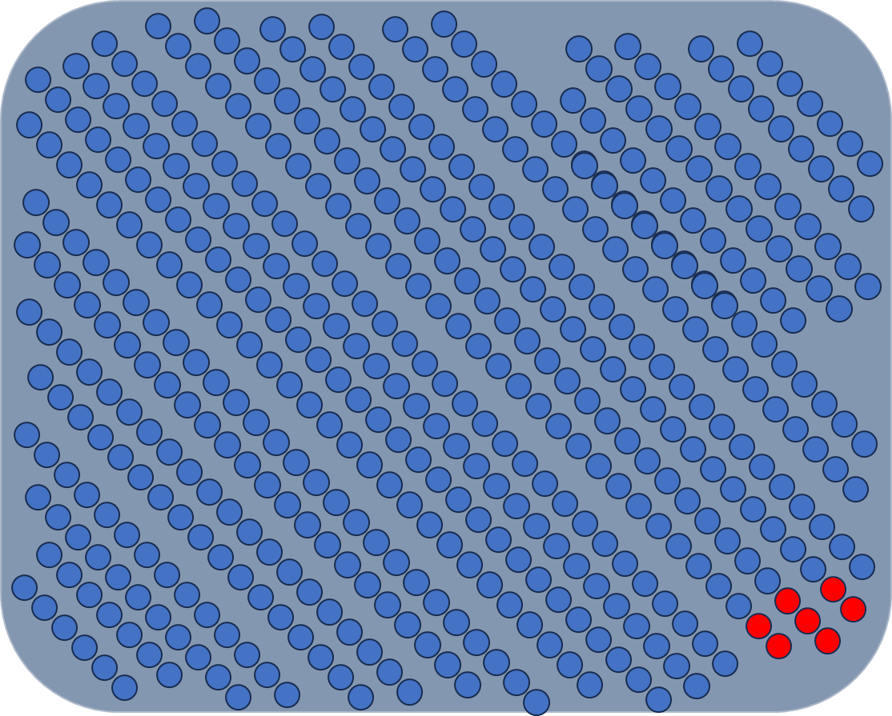

Slide 35
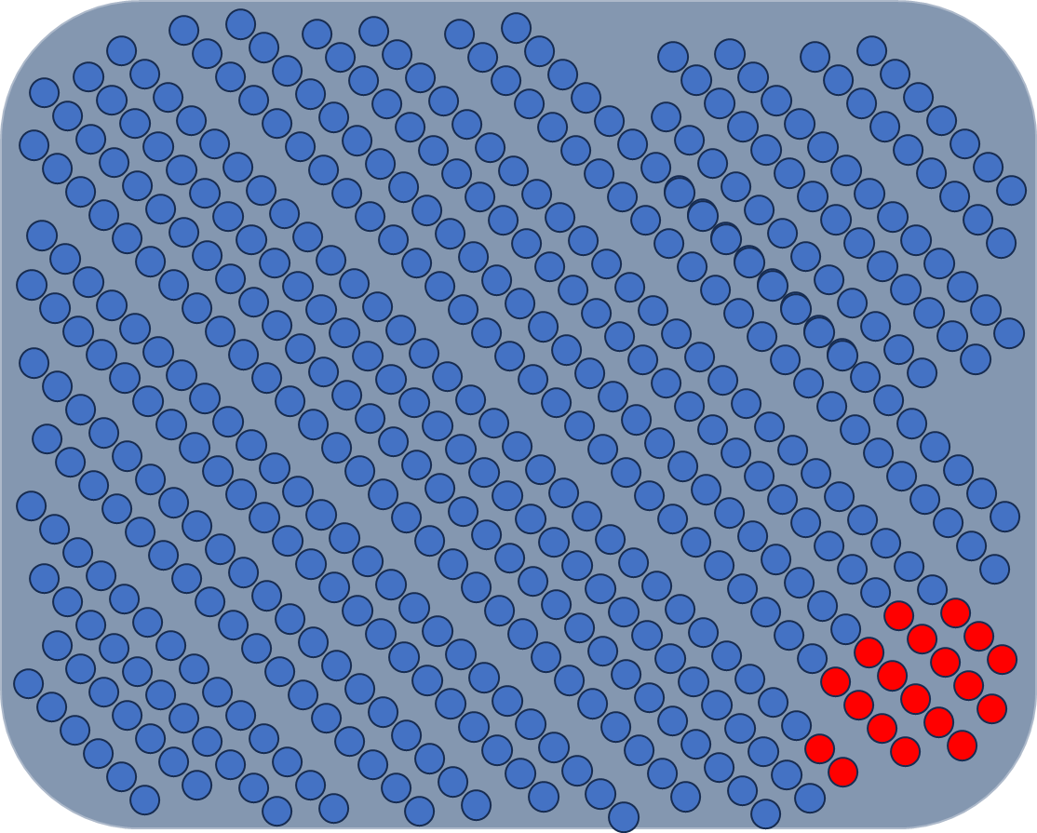

Slide 36
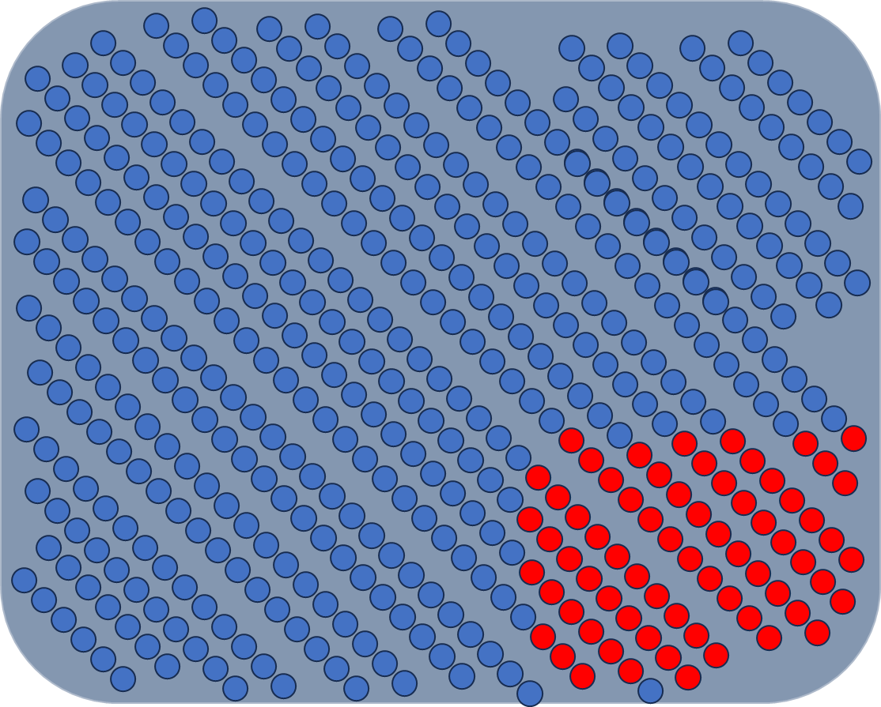

Slide 37
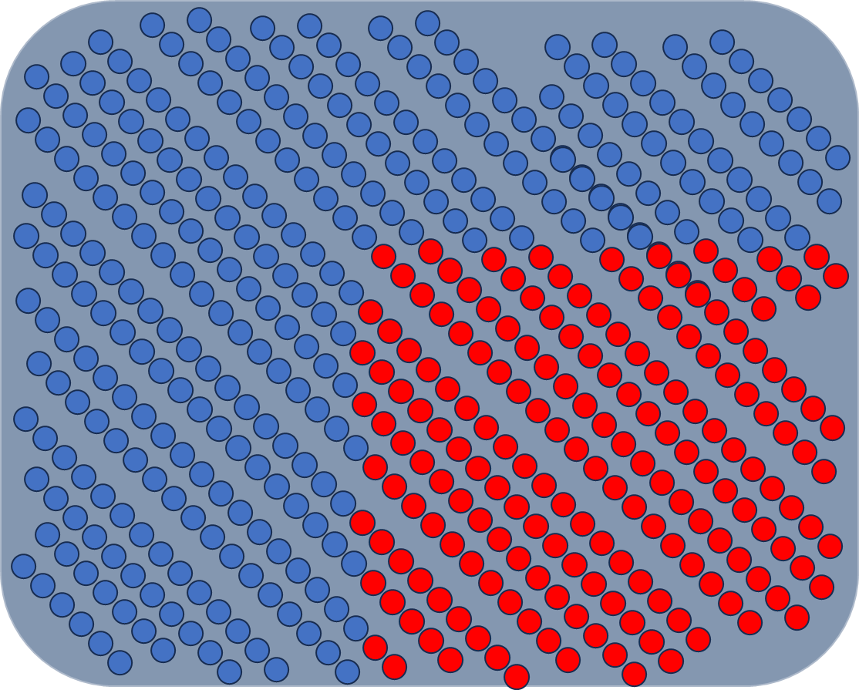

Slide 38
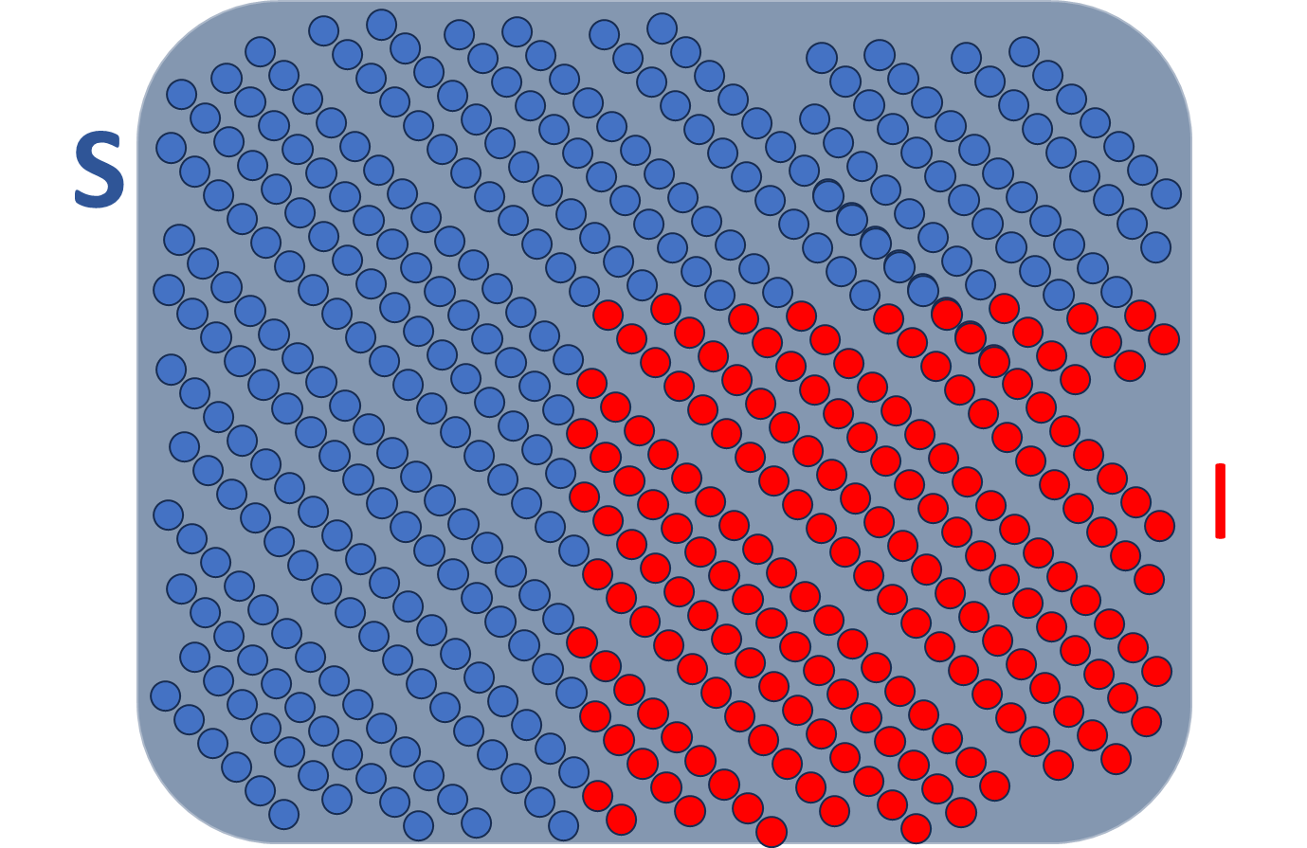
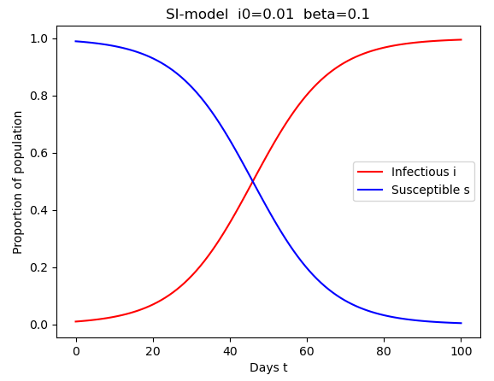
Simple SI model
N

Slide 39
Age-prevalence data allows for powerful inference into the dynamics of pathogen transmission.
S
βI
I
for a persistent, non-immunizing infection

Slide 40
Age-prevalence data allows for powerful inference into the dynamics of pathogen transmission.
S
λ
I
where λ, the force of infection, is the per capita rate at which susceptible hosts become infected

Slide 41
Age-prevalence data allows for powerful inference into the dynamics of pathogen transmission.
λ
with a persistent infection, we can assume that, if not infected, you must be susceptible….
1-I
I
where λ, the force of infection, is the per capita rate at which susceptible hosts become infected

Slide 42
Age-prevalence data allows for powerful inference into the dynamics of pathogen transmission.
λ
1-I
I
σ
and σ is the rate of recovery from infection

Slide 43
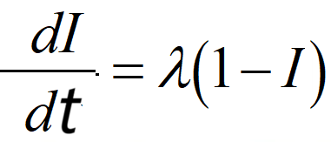
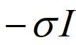
Age-prevalence data allows for powerful inference into the dynamics of pathogen transmission.
λ
1-I
I
λ
1-I
I
σ

Slide 44
Age-prevalence data allows for powerful inference into the dynamics of pathogen transmission.
λ(a)
1-I(a)
I(a)
λ(a)
1-I(a)
I(a)
σ

Slide 45
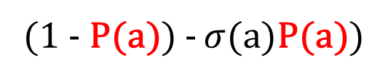
Age-prevalence data allows for powerful inference into the dynamics of pathogen transmission.
λ(a)
1-P(a)
P(a)
P(a)
(1 - P(a))
λ(a)
1-P(a)
P(a)
P(a)
(1 - P(a)) - $σ$(a)P(a))
σ
Compare using AIC = 2K - 2ln(L)
similar techniques can also be applied to age-seroprevalence data for immunizing infections

Slide 46
Let’s see which model works best for your data!

Slide 47
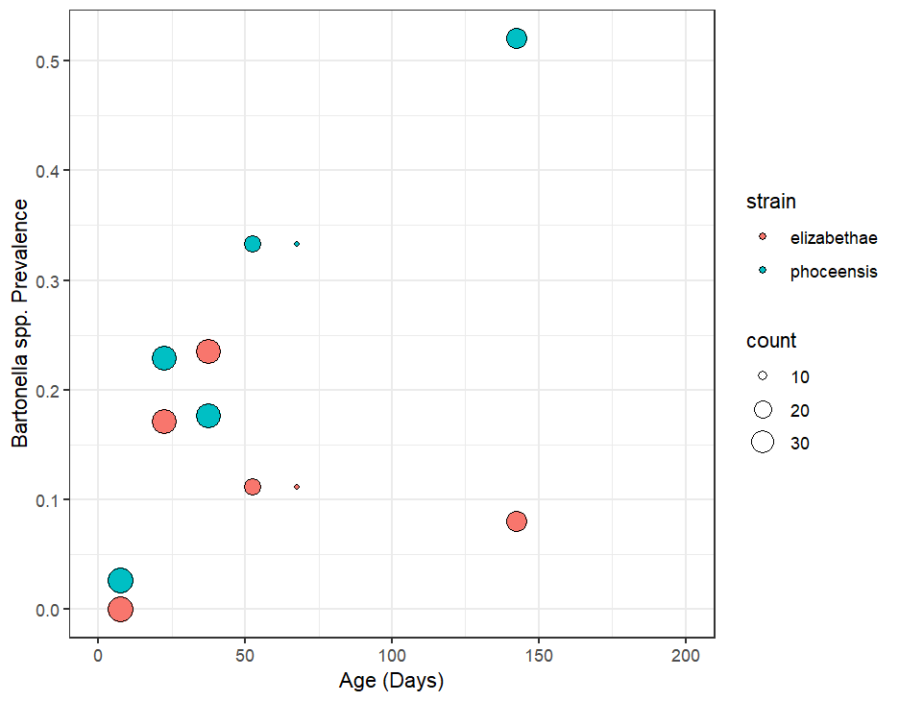
Look at the data !
Jereo aloha hoe manao ahoana

Slide 48
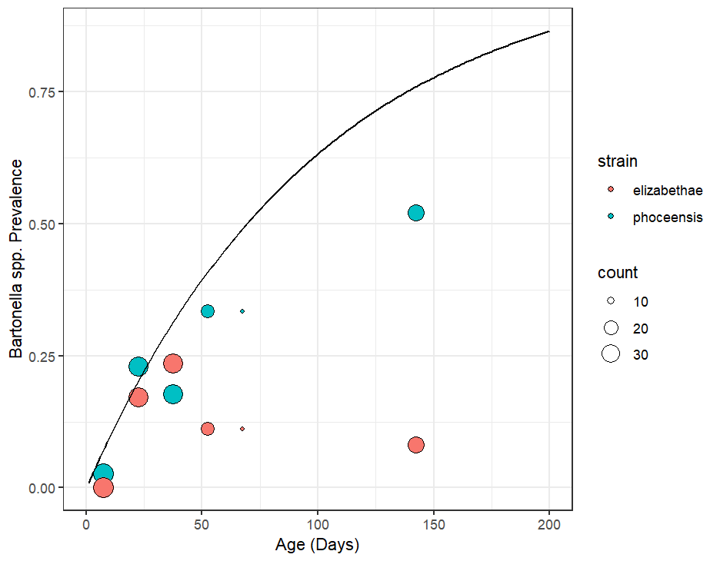
Try the model!
Andramo kely

Slide 49
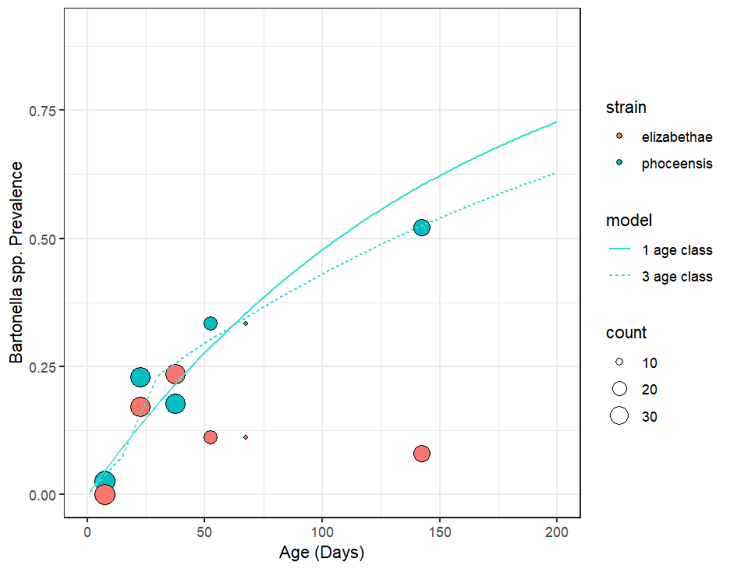
Keep trying!
Alô fô !
AIC =152
AIC =155

Slide 50
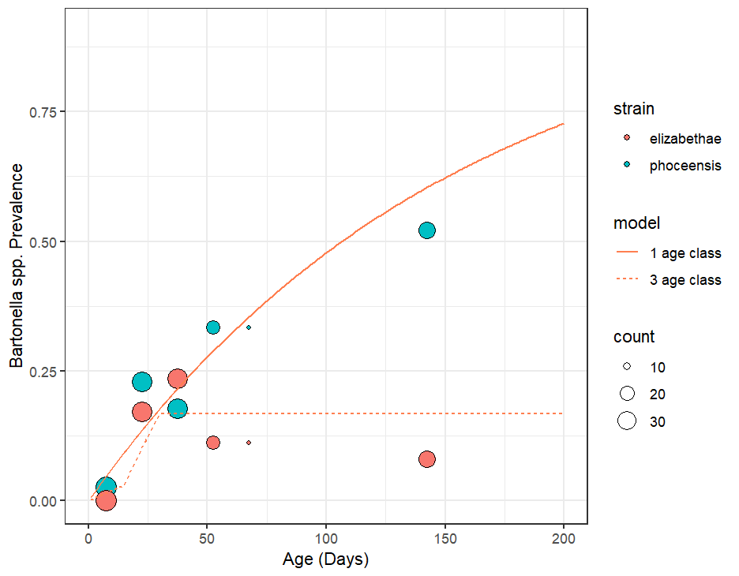
Keep trying!
AIC =126
AIC =114

Slide 51
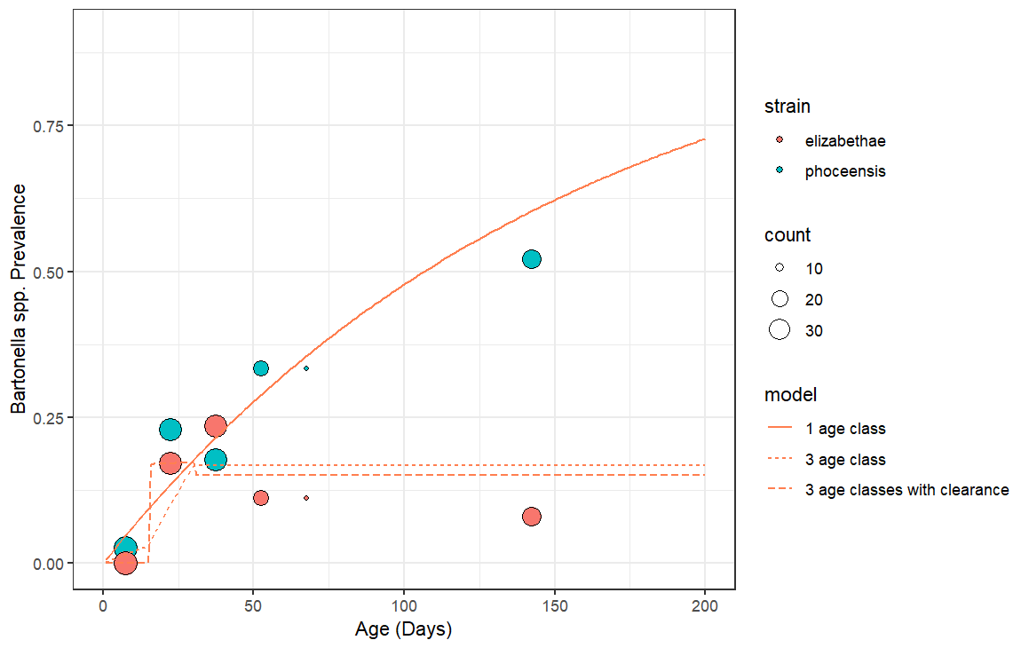
Keep trying!
AIC =126
AIC =114
AIC =113

Slide 52
We found that an SI model offered the best fit to B. phoceensis data while the SIS model offered the best fit to the B. elizabethae data.
λ
Bartonella phoceensis
prevalence
S
I
Force of Infection (days-1)
λ
Bartonella elizabethae
prevalence
S
I
Force of Infection (days-1)
σ
Age (days)
Age (days)

Slide 53
The age-structured FOI identifies age cohorts most influential in an epidemic. Juveniles showed the highest FOI.
λ
Bartonella phoceensis
prevalence
S
I
Force of Infection (days-1)
λ
Bartonella elizabethae
prevalence
S
I
Force of Infection (days-1)
σ
Age (days)
Age (days)

Slide 54
